Slide 1
The SUMMIT Study: Pulmonary Nodule and Incidental Findings in the First 10,000 Participants of a Population-Based Low-Dose CT Screening Study
Dr Jennifer L Dickson
University College London
United Kingdom
J L Dickson, University College London, United Kingdom

Slide 2
DISCLOSURES
Commercial Interest | Relationship(s)
GRAIL, Inc | Research Grant, Funder of the SUMMIT Study
Notes:
A commercial interest is defined as: any entity producing, marketing, re-selling, or distributing health care goods or services consumed by, or used on, patients.
If you do not have any relationships with commercial interests to disclose:
Delete the table from your slide
Include this statement on your slide: I do not have any relevant financial relationships to disclose.
If you do have relationships with commercial interests to disclose:
Complete the table by listing the name of each commercial interest in the first column, followed by the nature of the relationship(s) in the second column. (See example below)
Resize fonts and add rows, as needed, to fit the information into the table format
Examples of relationships include: Consultant, Speaker’s Bureau, Advisory Board, Ownership or Stock Interest, Employment, Honorarium, Financial Support from Tobacco Company(ies), Contracted/Support Research Grant, Royalty, Intellectual Property/Patient Holder
Example: Commercial Interest Relationship(s)
Roche: Speaker’s Bureau, Consultant
BMS: Honorarium, Advisory Board,Consultant
Pfizer: Contracted Support/Research

Slide 3
Introduction
Wider roll out of Lung Cancer Screening (LCS) in the UK requires a robust evidence base to support the management of screen detected:
        Pulmonary nodules (PNs)
        Incidental findings (IFs)
Why is this needed?
Minimise preventable harms
Optimise resource utilisation
To practically facilitate true population based LCS
From the first 10,000 participants enrolled in the SUMMIT Study, we report:
The prevalence of pulmonary nodules & Incidental findings
The impact a pre-defined management protocol has on repeat imaging & primary and secondary care referrals
Notes:
Adjust font size and placement as needed to fit your content.

Slide 4
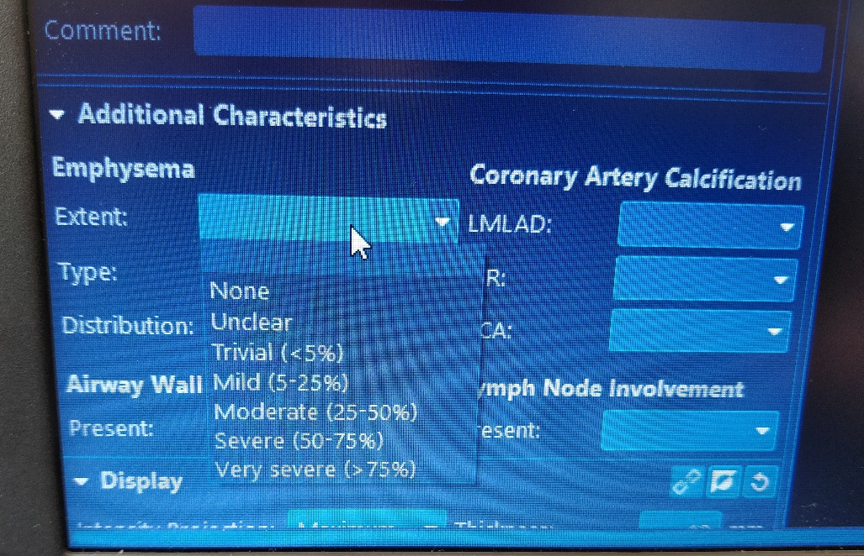
Methodology
Evidence based protocols were developed for the management of pulmonary nodules & incidental findings
A proforma-based radiology reporting system presents algorithm-derived management recommendations for the reporting radiologist to approve or override.
Figure 1: Example of proforma-based radiology reporting system
Notes:
Adjust font size and placement as needed to fit your content.

Slide 5
Table 1 – Pulmonary Nodule categorisation
Protocol-based baseline nodule management plan | Nodule type/size
1. No follow up (non-actionable nodules) | - Solid nodule (SN) <80mm³ or <6mm diameter - Ground Glass Nodule (GGN) <5mm diameter - Peri fissural nodule or intra-pulmonary lymph node
2. LDCT at 1 Year after baseline | - GGN ≥5mm diameter
3. LDCT at 3 Months after baseline | - Solid nodules (SN) ≥80mm³, <300mm³ or ≥6mm, <8mm diameter - SN ≥300mm³ or ≥8mm with Brock score <10% - Part-solid nodules (PSN)
4. Urgent referral by study clinicians for further investigation | - SN ≥300mm³ or ≥8mm diameter with Brock score >10%
Notes:
Adjust font size and placement as needed to fit your content.

Slide 6
Table 2 – Incidental findings categorisation
Protocol-based management plan | Example
1. Collected for research purposes only | - Coronary artery calcification (mild/moderate/severe) - Emphysema (mild/moderate/severe/very severe)
2. Ongoing annual LDCT within the study | - Adrenal nodule <4cm - Diffuse pleural thickening
3. Three-month follow up with repeat LDCT | - Consolidation
4. GP to action, with non-urgent referral to secondary care where appropriate | - Osteoporotic wedge fracture with >50% loss in height - Severe bronchiectasis - ILD with >10% reticulation - Bilateral pleural effusions
5. Urgent referral by study clinicians | - Large thoracic or abdominal aortic aneurysms - Suspected pulmonary tuberculosis - Any other suspected malignancy or emergency finding
Notes:
Adjust font size and placement as needed to fit your content.

Slide 7
Results
Figure 1 – Pulmonary nodule findings
10,000
Participant baseline LDCT
10,288*
SN <80mm^{3 or} GGN <5mm
3,110*
Actionable PNs
810
GGN ≥5mm diameter
1,912
SN ≥80, <300mm³ or PSN
388
SN ≥300mm³ or ≥8mm with Brock score >10%
No further management
12 month interval
LDCT
3 month interval
LDCT
Urgent MDT
referral
*The total number of nodules exceeds the number of participants as these are reported on a per nodule basis

Slide 8
Results
Figure 2 – Incidental findings
16,581 IFs
(In 8,262 participants)
Collected for research purposes only
Actionable IFs
14,608
e.g. Coronary artery calcification, emphysema
409
Ongoing annual LDCT within SUMMIT
786
3 month interval LDCT within SUMMIT
505
GP to
action
273
Urgent MDT
referral

Slide 9
Conclusion
Implementation of defined PN and IF protocols has enabled streamlined management of radiological findings
The referral rates for PNs and IFs are low when compared to previously reported studies, though direct comparison is difficult due to heterogeneous data collection and reporting between studies
Forthcoming outcome data from the SUMMIT Study will further inform whether this strategy can be recommended more widely
Notes:
Adjust font size and placement as needed to fit your content.

Slide 10
Take-Home Messages
Pulmonary Nodules and Incidental Findings on LDCT LCS are common
Evidence-based protocols facilitate sensible management outcomes
Further data will be collected through the SUMMIT Study to inform how to refine and improve management of PNs and IFs in the future
Notes:
Please include one or two "pearls" or "take home" sentences that summarize key points of your content.

