Slide 1
Stage Shift by Screening with a Multi-Cancer Early-Detection Test: Microsimulation Modeling to Inform the Design of a Pragmatic Randomized Controlled Trial
Jing Zhang, Jerome V. Braun, Noah Simon, Earl Hubbell, Nan Zhang
2021 Joint Statistical Meetings
August 12, 2021

Slide 2









Overview
Only 4 cancer types have USPSTF-recommended routine screening programs.
~ 2/3rd cancer deaths in the US are from cancers without screening modalities.¹
Screened Cancers
Limitations
Breast
Cancer
Lung
Cancer
Discomfort & Inconvenience
Radiation
Exposure
Colon
Cancer
Cervical
Cancer
False
Positives
Missed
Cancers
!
USPSTF, United States Preventive Services Task Force.
¹American Cancer Society. Cancer facts & figures 2020. CA Cancer J Clin. Published online 2020.
US-GRL-2000037
Notes:
Cancer screening aims to prevent cancer death by detecting cancerous lesions early.
Most cancers lack available screening modalities (except colorectal, breast, lung, cervical and prostate).
USPSTF recommendations: high-risk only for lung; individual decision for prostate.
Breast - biennial screening mammography for women aged 50 to 74 years (B).
Lung - annual screening for lung cancer with low-dose computed tomography (LDCT) in adults aged 50 to 80 years who have a 20 pack-year smoking history and currently smoke or have quit within the past 15 years (B).
Colon - all adults aged 50 to 75 years (A). stool-based tests (gFOBT, FIT, sDNA-FIT) and visualization tests (colonoscopy, CT colonograph, flexible sigmoidoscopy, flexible sigmoidoscopy with FIT). 45 to 49 years (B)
Cervical (A) - The USPSTF recommends screening for cervical cancer every 3 years with cervical cytology alone in women aged 21 to 29 years. For women aged 30 to 65 years, the USPSTF recommends screening every 3 years with cervical cytology alone, every 5 years with high-risk human papillomavirus (hrHPV) testing alone, or every 5 years with hrHPV testing in combination with cytology (cotesting).

Slide 3



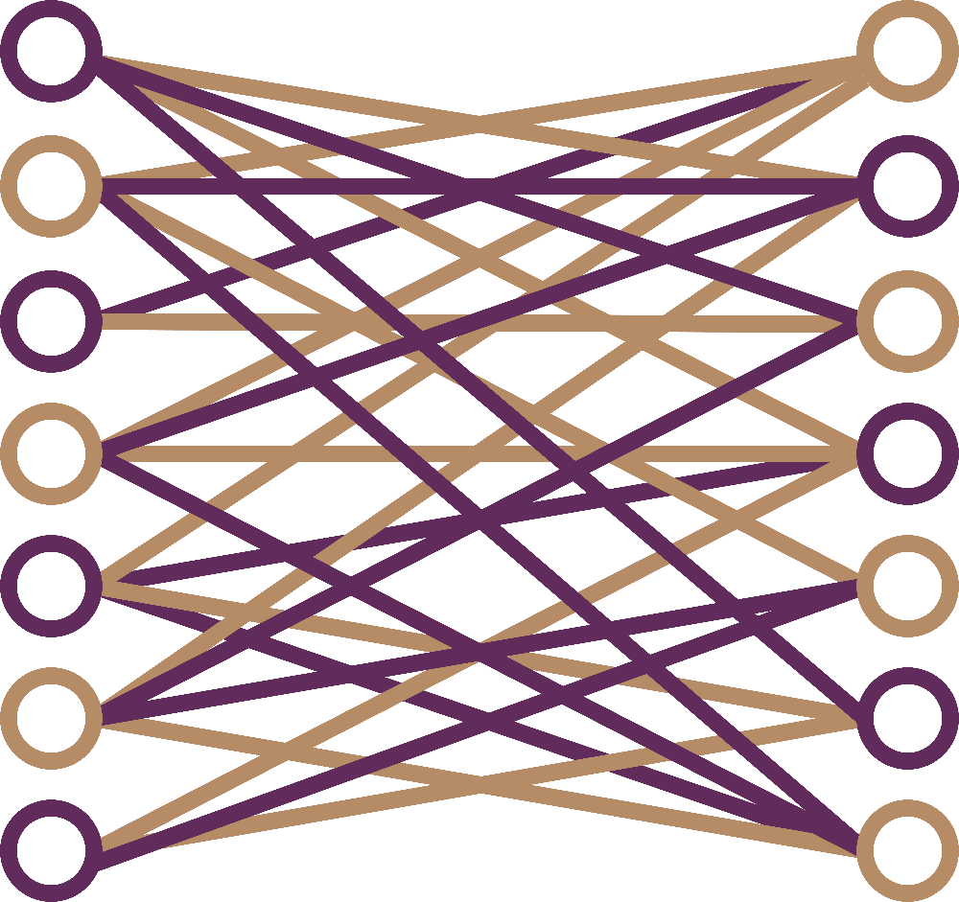
Overview
GRAIL Has Developed a Multi-Cancer Early Detection (MCED) Test -- Galleri^{TM1}
Colorectal
Esophageal
Head & Neck
Liver
Lung
Lymphoma
Plasma Cell Neoplasm
Pancreatic
Ovarian
Stomach
Anus
Bladder
Single blood draw
Detect cancer signal with targeted methylation sequencing and machine-learning classifiers
50+ AJCC cancer types
Test is intended to complement guideline-recommended screening
(eg, mammography)
Designed to detect many lethal cancers, including unscreened types
High specificity (99.5%)
minimizes false positives and unnecessary work-ups
AJCC, American Joint Committee on Cancer.
¹Galleri was developed, and its performance characteristics determined, by the GRAIL. Inc. Clinical Laboratory in Menlo Park, CA USA. Galleri has not been cleared or approved by the U.S. Food and Drug Administration.

Slide 4
Overview
UK NHS’s Long Term Plan:
  To increase detection of stage I or II cancers to 75% by 2028.
UK NHS is conducting a large-scale pragmatic randomised controlled trial (PRCT) of this MCED test to evaluate stage shift:
  Primary Objective: To show significant reduction in late-stage cancers.
    Late-stage reduction is a surrogate endpoint for cancer-specific mortality reduction (advocated by experts in cancer screening).
    Late-stage reduction will be achieved earlier in time, which offers an opportunity to start to save lives earlier.
  To contribute to the NHS’s Long Term Plan.
This PRCT will take a few years to assess stage shift.
MCED, Multi-Cancer Early Detection; NHS, National Health Service; PRCT, Pragmatic Randomized Controlled Trial.

Slide 5
Overview
Question: Is there any modeling that can efficiently provide insight into the possible outcomes of the NHS PRCT?
Microsimulation can be an efficient and flexible approach.
  Individual trajectories instead of deterministic mean response.
  Account for variation: stochastic & individual characteristics.
But few tackle multi-cancer tests.
Therefore
We proposed a novel microsimulation model targeting multi-cancer tests.
  Simulated the NHS’s PRCT.
  Modeled Stage shift.
    Additionally, with extended follow-up, modeled mortality reduction.
MCED, Multi-Cancer Early Detection; NHS, National Health Service; PRCT, Pragmatic Randomized Controlled Trial.
Notes:
Rd e

Slide 6
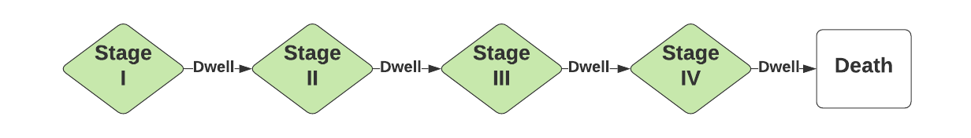
Methods: Natural History of Cancer and Individual Cancer Trajectories
Natural history of cancer
Notes:
Noninvasive cancer does not spread outside of the tissue in which it initially formed. Some doctors may refer to it as carcinoma in situ or precancer.

Slide 7
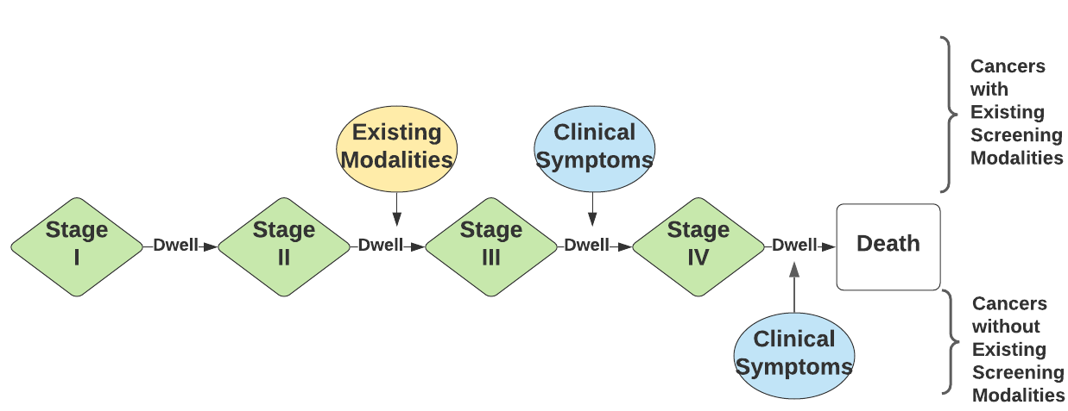
Methods: Natural History of Cancer and Individual Cancer Trajectories
Hypothetical illustration of detection by routine care
Note that for cancers without existing screening modalities, clinical symptoms can arise at any stage, but are most likely at later stages, particularly stage IV.¹
¹Narayan A, Fischer A, Zhang Z, Woods R, Morris E, Harvey S. Nationwide cross-sectional adherence to mammography screening guidelines: national behavioral risk factor surveillance system survey results. Breast Cancer Res Treat. 2017;164(3):719-725.

Slide 8
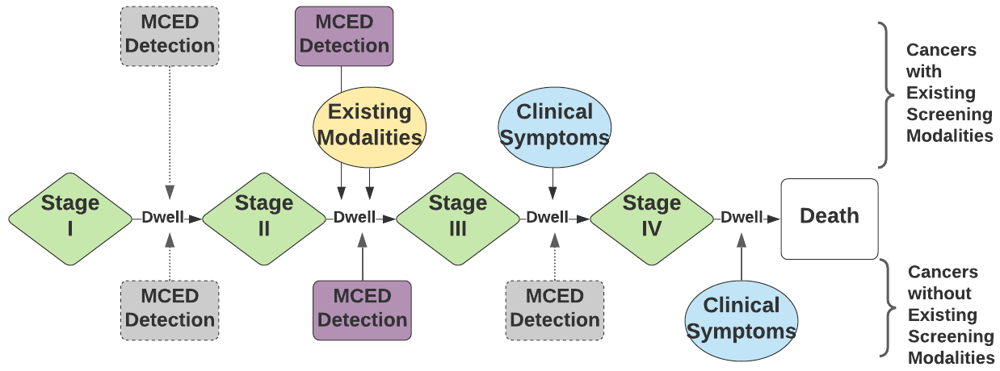
Methods: Natural History of Cancer and Individual Cancer Trajectories
Hypothetical illustration of earlier interception by the MCED
“MCED Detection” in purple is one arbitrary example and “MCED detection” in gray shows other possibilities. “MCED Detection” during the dwell time between stage II and III will result in a diagnosis of stage II cancer.
Note: The MCED’s intended use population is asymptomatic.
MCED, Multi-Cancer Early Detection.

Slide 9
Methods: Modeling Natural History of Cancer and Detection by Routine Care
Used the CCGA3 test performance data.
Used US SEER incidence, stage and survival input data.
T(Original diagnosis): Exponential distribution with mean rate to match the SEER incidence.
Cancer type & Original stage: Multinomial distribution according to empirical SEER data.
Preclinical trajectory = T(Original diagnosis) - T (current stage) - T(previous stages).
T=Dwell time: Exponential distribution; Representing tumor growth rate.
  Slow (3-7 years in stage I), fast (2-4 years), and aggressively fast (1-2 years).¹
T(Original mortality): Linear interpolation of empirical SEER survival data.
CCGA3, Circulating Cell-free Genome Atlas (CCGA; NCT02889978) Sub-study 3; SEER, Surveillance, Epidemiology, and End Results (National Cancer Institute).
¹Hubbell E, Clarke CA, Aravanis AM, Berg CD. Modeled reductions in late-stage cancer with a multi-cancer early detection test. Cancer Epidemiol Prev Biomark. 2021;30(3):460-468.
Notes:
representing tumor growth rate.

Slide 10
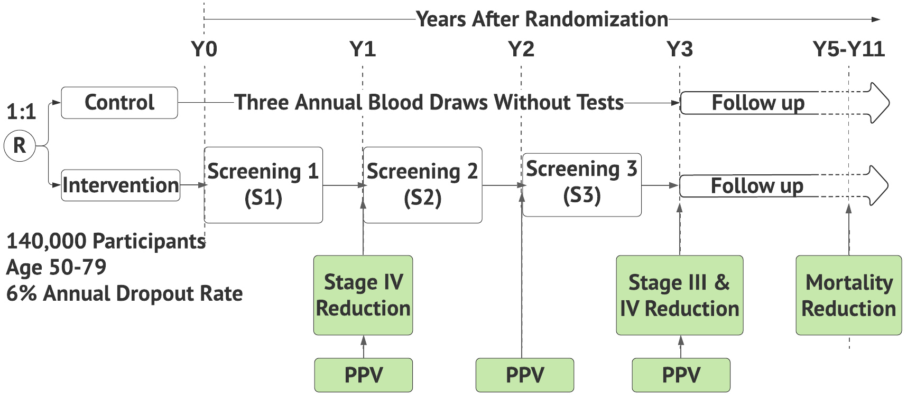
Methods: Modeling Screening with the MCED Test
Screening Schema
Primary Objective of
NHS PRCT
NHS PRCT Not Designed or Powered for Mortality Reduction
Screening schema illustrating both the simulated pragmatic PRCT structure and the outcome measures at different study lengths.
MCED: Multi-Cancer Early Detection; PPV, Positive Predictive Value; PRCT, Pragmatic Randomized Controlled Trial.

Slide 11
Methods: Modeling Screening with the MCED test
Screening with the MCED test can detect cancers at earlier stages and extend survival.
  Detection by the MCED of preclinical invasive cancer was dependent on the MCED’s sensitivity.
  Detected at an earlier stage An update of cancer-specific mortality event.
    Surviving to the original date of diagnosis;
    Following the interpolated distribution for survival based on the updated stage at detection translated to the original diagnosis time.
  Updated time to cancer diagnosis, stage and mortality.
MCED, Multi-Cancer Early Detection.

Slide 12
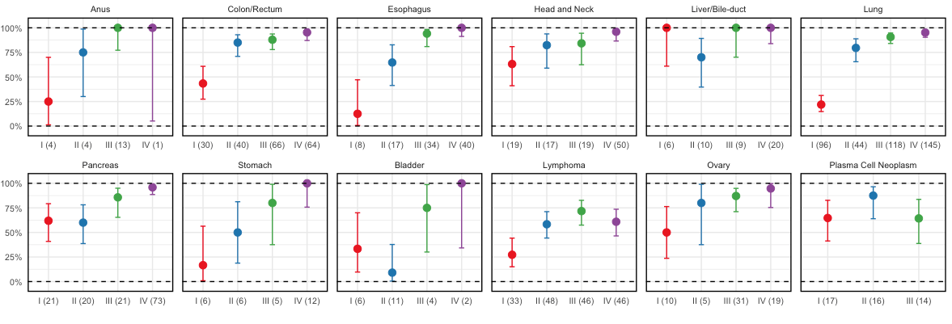
Methods: Modeling Intervention by Screening with the MCED test
CCGA3 study provided performance data.
  The overall specificity was 99.5%.
  Sensitivity by cancer class by stage was estimated using isotonic MCMC.
    Example: sensitivities of cancers that account for ⅔ deaths in the US.
CCGA3, Circulating Cell-free Genome Atlas (CCGA; NCT02889978) Sub-study 3; MCED, Multi-Cancer Early Detection; MCMC, Markov-chain Monte Carlo.
Notes:
Pancreas; head & neck

Slide 13
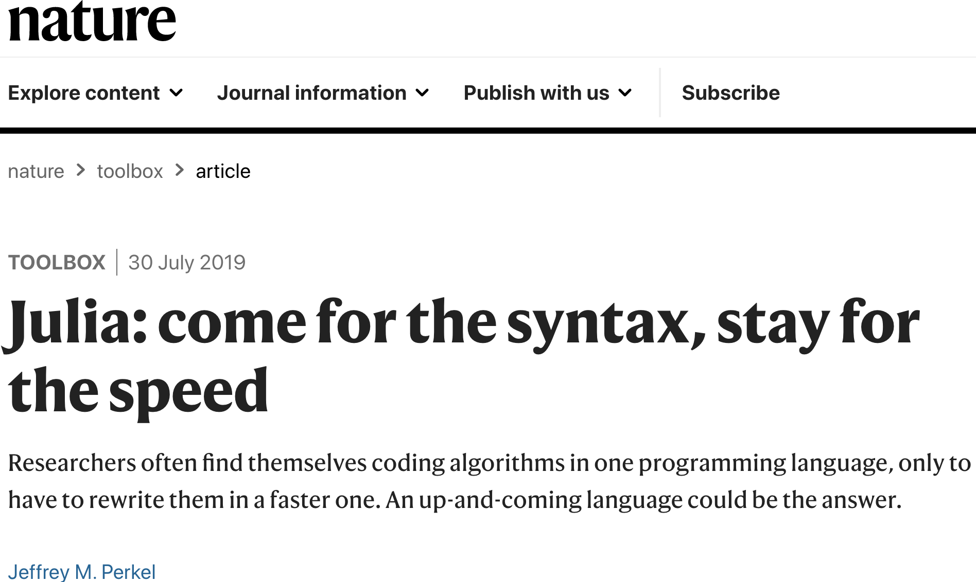
Methods: Powerful Language Julia with Parallel Computing
Julia is an open-source language that combines the interactivity and syntax of “scripting” languages, such as R and Python, with the speed of “compiled” language such as C.
Rapid prototyping and production.
Overcomes the two-language problem.
User-friendly distributed computing.
  Parallel running across 96 cores on Amazon EC2 M5 instance.
Fast, easy, powerful!
Notes:
Rapid prototyping and development. Examples: tenfold faster then Python @ CIT; 800-fold faster than R @ U of Melbourne, Australia

Slide 14
Outcomes: Intercept Cancers Earlier in Time
Table 1. Cumulative proportions of more cancers detected in the interventional arm compared with the control arm after three rounds of screening*
Tumor growth‡ | Prevalent screening | Y3 (Cum.§) | Y11† (Cum.)
Slow | 123.83% (102.77% to 146.98%) | 44.58% (35.96% to 53.56%) | 7.71% (3.87% to 11.51%)
Fast | 72.63% (55.63% to 88.62%) | 26.06% (18.26% to 34.72%) | 3.74% (−0.17% to 8.12%)
Aggressively fast | 32.10% (19.32% to 46.87%) | 11.87% (5.41% to 18.91%) | 1.45% (−2.41% to 5.52%)
Prevalent screening (screening-naive): intercepted most cancers (that would eventually surface clinically) that were routine care undetectable but MCED detectable at the time of screening.
Incident screenings (screening-experienced): intercepted additional such cancers and newly developed cancers also earlier in time.
MCED intercepted cancers years earlier.
*CIs that include 0 are in bold.
†Y11 reflects a study length of 11 years after randomization.
‡Three different tumor growth rates were represented by three sets of dwell times in modeling.
§Cum.=Cumulatively.
CI: Confidence Interval; MCED, Multi-Cancer Early Detection.

Slide 15
Outcomes: Significant Reduction in Stage III and IV Cancers
Table 2. Cumulatively absolute and relative reductions of stage III and IV cancers after three rounds of screening*
Tumor growth† | Stage III and IV cancers |  | Absolute reduction | Relative reduction | Power‡
 | Control | Intervention
Slow | 735 (683 to 789) | 558 (508 to 609) | 177 (104 to 249) | 23.93% (14.86% to 32.34%) | 97.60%
Fast | 737 (686 to 786) | 533 (486 to 587) | 203 (126 to 278) | 27.49% (18.05% to 35.97%) | >99%
Aggressively fast | 734 (680 to 785) | 511 (462 to 555) | 223 (151 to 296) | 30.31% (21.85% to 38.11%) | >99%
Relative reduction of late stage cancer is >23%.
Power to detect a significant reduction is >97%.
*Results summarized at Y3.
†Three different tumor growth rates were represented by three sets of dwell times in modeling.
‡Power to detect a significant reduction with a two-sided test.

Slide 16
Outcomes: Increased Detection of Early-Stage Cancers
Table 3. Cumulative proportion of stage I and II cancers after three rounds of screening*
Tumor growth† | Control | Intervention
Slow | 62.07% (59.89% to 64.26%) | 80.06% (78.16% to 81.82%)
Fast | 62.04% (60.26% to 64.01%) | 78.18% (76.18% to 80.15%)
Aggressively fast | 62.13% (59.99% to 64.19%) | 76.43% (74.46% to 78.39%)
NHS Long Term Plan achievable.
Proportion of detected stage I and II cancers increased from approximately 62% to over 76% for all tumor growth rates.
Note: 62% is for US population based on SEER data; UK may have a lower percentage of early stage cancers¹.
*Results summarized at Y3.
†Three different tumor growth rates were represented by three sets of dwell times in modeling.
¹Coleman MP, Forman D, Bryant H, et al. Cancer survival in Australia, Canada, Denmark, Norway, Sweden, and the UK, 1995–2007 (the International Cancer Benchmarking Partnership): an analysis of population-based cancer registry data. The Lancet. 2011;377(9760):127-138.
NHS, National Health Service; SEER, SEER, Surveillance, Epidemiology, and End Results (National Cancer Institute).

Slide 17
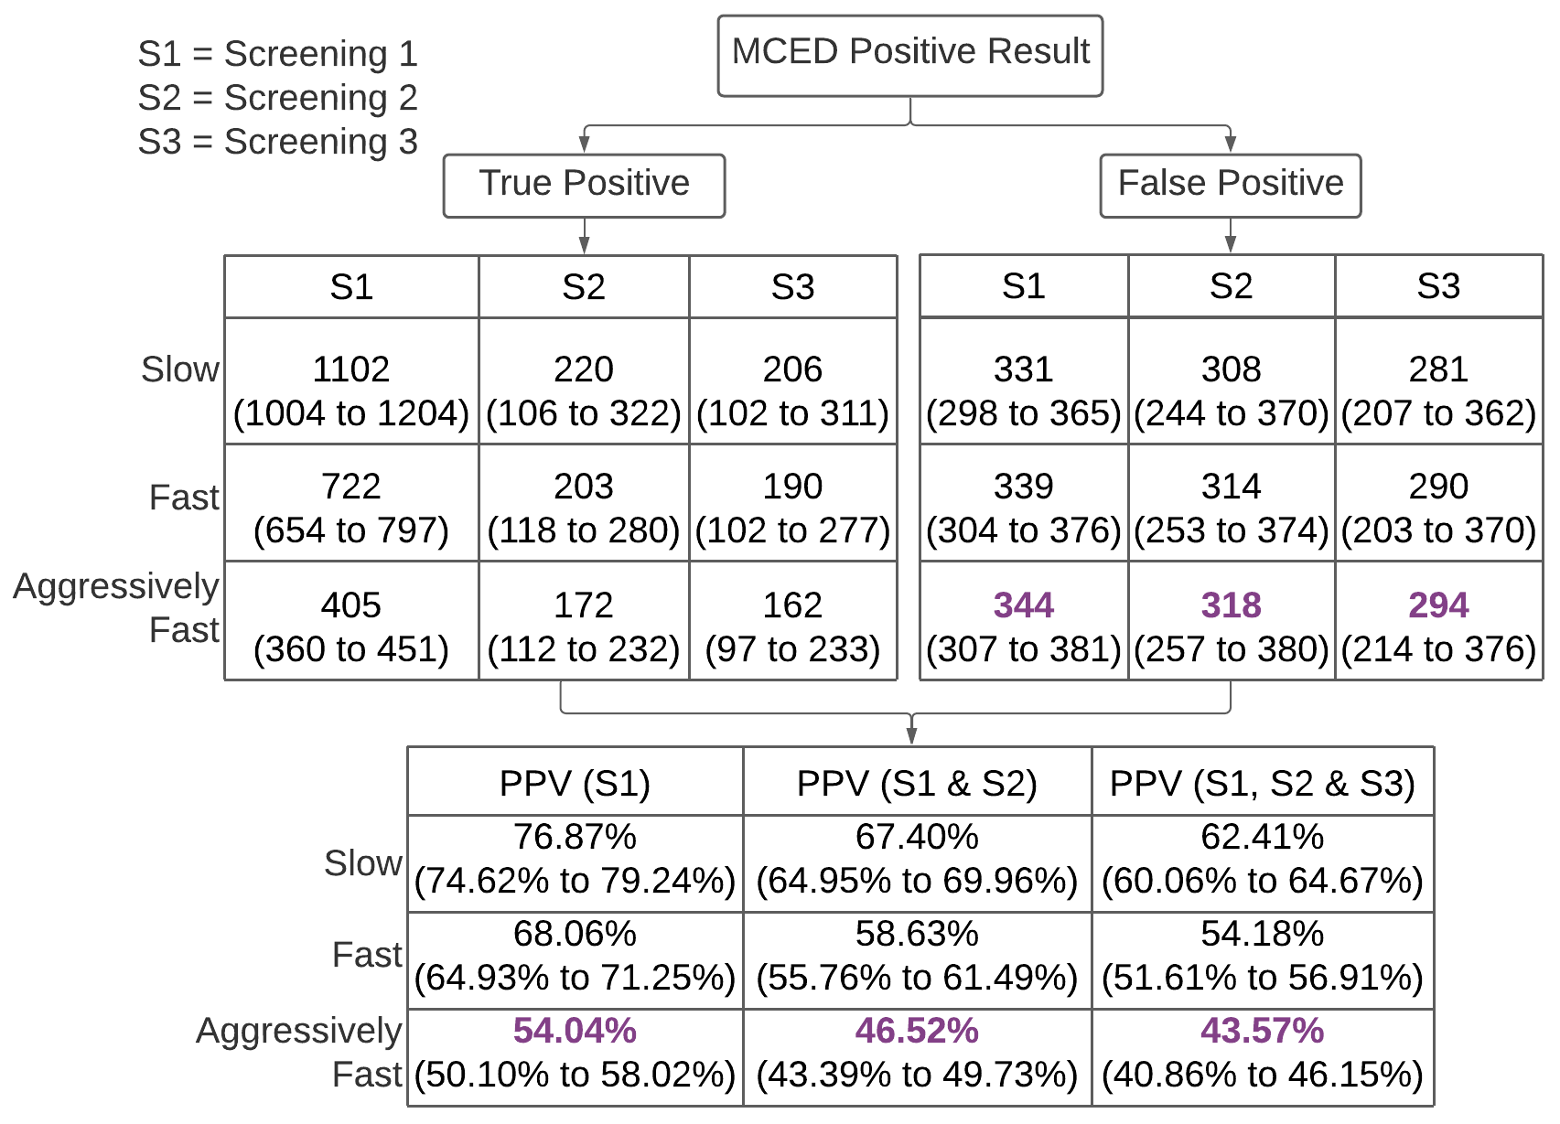
Outcomes: FPs, PPVs
Low false positive numbers: false positive rate= 0.5%.
Estimated PPV: higher than those of most accepted single cancer screening tests.
FP: False Positive; MCED: Multi-Cancer Early Detection; PPV: Positive Predictive Value.

Slide 18
Additional Modeling Outcomes: Cancer-specific Mortality Reduction
Table 4. Cancer-specific mortality reduction
Study length | Tumor growth† | Deaths per 1000 person-years |  | Rate ratio | Power‡
 |  | Control | Intervention
Y5* | Slow | 1.88 (1.74 to 2.02) | 1.50 (1.37 to 1.64) | 0.80 (0.72 to 0.89) | 97.6%
 | Fast | 1.88 (1.74 to 2.03) | 1.53 (1.40 to 1.66) | 0.81 (0.72 to 0.90) | 95.6%
 | Aggressively fast | 1.88 (1.74 to 2.02) | 1.55 (1.43 to 1.68) | 0.83 (0.74 to 0.92) | 92.0%
Around 20% mortality reduction.
Power >=92%.
Note:
The NHS PRCT was not designed to show mortality reduction.
Late-stage reduction is a surrogate endpoint and can be achieved earlier, providing an opportunity to save lives earlier.
*Results reflect a study period of 5 years after randomization.
†Three different tumor growth rates were represented by three sets of dwell times in modeling.
‡Power to detect a significant mortality reduction with a two-sided exact test.
NHS, National Health Service; PRCT, Pragmatic Randomized Controlled Trial.

Slide 19
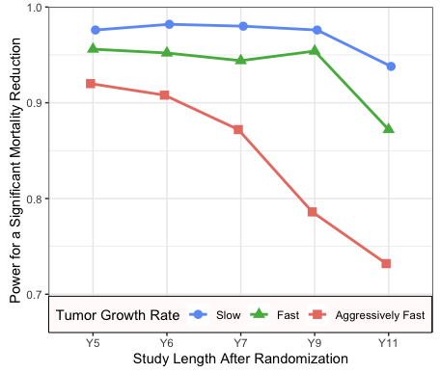
Additional Modeling Outcomes: Cancer-specific Mortality Reduction
A drop in power is likely starting from Y7-Y9 due to the lack of routine, periodic screenings (i.e., only three rounds in the NHS PRCT and our modeling).
A limited screening period with an extended observation period may underestimate the benefit of screening.¹
Note:
The NHS pragmatic RCT was not designed to show mortality reduction.
Late-stage reduction is a surrogate endpoint and can be achieved earlier, providing an opportunity to save lives earlier.
Power to detect a significant mortality reduction for different lengths of follow-up under different tumor growth rates.
¹Duffy SW, Smith RA. A note on the design of cancer screening trials. J Med Screen. 2015;22(2):65-68.
NHS, National Health Service; PRCT, Pragmatic Randomized Controlled Trial.

Slide 20
Discussion: Complexities Addressed & Remaining Limitations
Complexities Addressed
UK data not available used US SEER data. However, late-stage cancer more frequent in the UK our results could be conservative.
Preclinical natural history of cancers detectable by cfDNA is largely unknown conducted Robust analysis by varying the dwell time (i.e., tumor growth rate) scenarios.
Uncertainties in sensitivity estimates applied MCMC.
Remaining Limitations
Did not model the pathways to diagnosis; assumed to be effective.
Did not model overdiagnosis (cancers that would not surface clinically).
Extrapolated performance from a case-control study to a preclinical domain.
cfDNA, cell-free DNA; MCMC, Markov chain Monte Carlo; SEER: Surveillance, Epidemiology, and End Results (National Cancer Institute).

Slide 21
Discussion: Key Summary
Proposed a novel microsimulation modeling to demonstrate potential benefit of adding the MCED test to routine care.
Early-stage cancer detection increased from approximately 62% to over 76%.
Relative reduction of late-stage cancer was over 24% (Power>97%).
Estimated PPV was higher than most accepted single cancer screening tests.
The likelihood of severe harm due to the MCED test was low, with an FP rate of 0.5%.
Additionally with a much longer follow-up period,
Stage shift resulted in a cancer-specific mortality reduction of around 20%.
Modeling results informed that:
A widespread adoption of the MCED test in the UK may help the NHS achieve its Long Term Plan of diagnosing 75% cancers at early stage by 2028, save lives, and improve cancer care.
MCED, Multi-Cancer Early Detection; NHS, National Health Service; PPV, Positive Predictive Value.

Slide 22
Acknowledgement
We thank Dr. Christina A. Clarke for obtaining the SEER incidence and survival data.
We thank Dr. Stephannie Shih for assistance in generating the tables and figures.
We thank Drs. Arash Jamshidi, Deepshikha Bhandari, Megan Hall, Amy Sinor-Anderson, I-Zu Huang, Phillip Kiefer, Nathan Hunkapiller, Harpal Kumar and Josh Ofman for their constructive comments.

